Slide 1
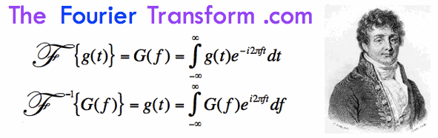
Fast Fourier Transforms
By Jacob Riedel and Deniz Celik

Slide 2
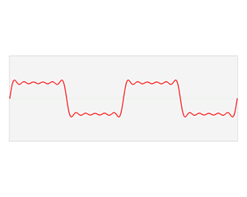

What is a Fourier Transform?
Converts a signal between the time domain and frequency domain.
The Fourier Transform is a result of the study of a Fourier Series.

Slide 3
Fourier Series
The Fourier Series is an approximation of complex signals by summing simpler sine and cosine functions
The transform is produced when these approximations are allowed to continue until time goes to infinity.

Slide 4

Discrete Fourier Transform
A Discrete Fourier Transform take a finite number of points from a complex sinusoid and transforms it using summation, rather then integration.

Slide 5
Fast Fourier Transform
A Fast Fourier Transform is an Algorithm which makes computing a Discrete Fourier Transform computationally easier.
A FFT will produce the same values as a DFT in less time.
FFT can actually be more accurate than DFT in the presence of rounding errors.

Slide 6
FFT Algorithms
There are many different algorithms used in computing FFT.
Cooley-Tukey Algorithm is a divide-and-conquer method, using recursion and breaking down DFTs.
Their algorithm is inspired by I. J. Good’s Prime Factorization Algorithm.
Their formula was actually a rediscovery of Carl Friedrich Gauss’s algorithm

Slide 7
Code Demo
Slow:
Uses Matrix Multiplication
Fast:
Uses Cooley-Tukey Algorithm
Symmetry of Fourier Transform – Odd is Even???
Numpy:
Uses Optimized Cooley-Tukey Algorithm
Tweaked and Written in Fortran

Slide 8
Applications
Solving Differential Equations
Much like Laplace Transforms
Signal Processing
Image Processing
Nuclear magnetic resonance and MRI's
Tomography – Delay in time is phase shift
Convolution:
Is multiplication in Frequency

